Slide 1


Chapter 5
Link Layer
Computer Networking: A Top Down Approach
6th edition
Jim Kurose, Keith Ross
Addison-Wesley
March 2012
Link Layer
5-<number>

Slide 2
MAC addresses and ARP
32-bit IP address:
  network-layer address for interface
  used for layer 3 (network layer) forwarding
  An IP address is a unique address that identifies a device on the internet or a local network
MAC (or LAN or physical or Ethernet) address:
  function: used ‘locally” to get frame from one interface to another physically-connected interface (same network, in IP-addressing sense)
  48 bit MAC address (for most LANs) burned in NIC ROM, also sometimes software settable
  e.g.: 1A-2F-BB-76-09-AD
hexadecimal (base 16) notation
(each “number” represents 4 bits)
Link Layer
5-<number>

Slide 3
MAC
A media access control address (MAC address) is a unique identifier assigned to a network interface controller (NIC) for use as a network address in communications within a network segment.
Data Link Layer
5-<number>

Slide 4
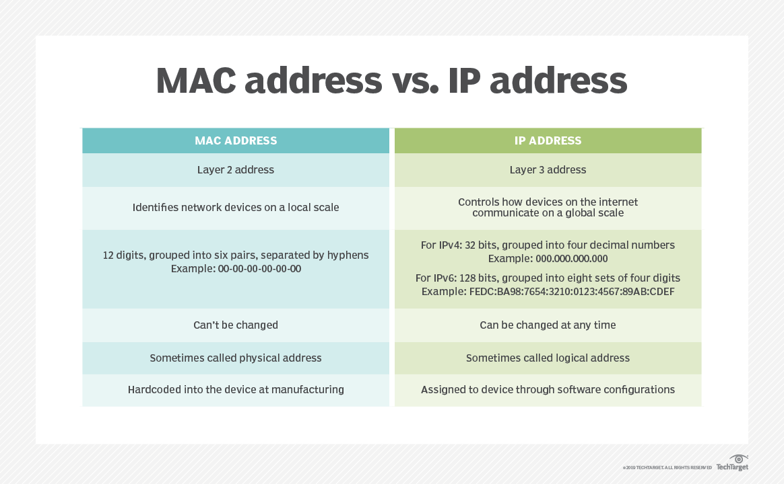
MAC VS IP address
Data Link Layer
5-<number>

Slide 5

LAN addresses and ARP
each adapter on LAN has unique LAN address
1A-2F-BB-76-09-AD
LAN
(wired or
wireless)
adapter
71-65-F7-2B-08-53
58-23-D7-FA-20-B0
0C-C4-11-6F-E3-98
Link Layer
5-<number>

Slide 6
LAN addresses (more)
MAC address allocation administered by IEEE
manufacturer buys portion of MAC address space (to assure uniqueness)
analogy:
  MAC address: like Social Security Number
  IP address: like postal address
MAC flat address ➜ portability
  can move LAN card from one LAN to another
IP hierarchical address not portable
  address depends on IP subnet to which node is attached
Link Layer
5-<number>

Slide 7
ADDRESS MAPPING
The delivery of a packet to a host or a router requires two levels of addressing: logical and physical. We need to be able to map a logical address to its corresponding
physical address and vice versa. This can be done by using either static or dynamic mapping.
21.<number>

Slide 8
Why ARP is necessary
ARP is necessary because the software address (IP address) of the host or computer connected to the network needs to be translated to a hardware address (MAC address). Without ARP, a host would not be able to figure out the hardware address of another host.
Data Link Layer
5-<number>

Slide 9

ARP operation
21.<number>

Slide 10

ARP packet
21.<number>

Slide 11
An ARP request is broadcast;
an ARP reply is unicast.
21.<number>

Slide 12
Example
A host with IP address 130.23.43.20 and physical address B2:34:55:10:22:10 has a packet to send to another host with IP address 130.23.43.25 and physical address A4:6E:F4:59:83:AB. The two hosts are on the same Ethernet network. Show the ARP request and reply packets encapsulated in Ethernet frames.
Solution
Figure 21.5 shows the ARP request and reply packets. Note that the ARP data field in this case is 28 bytes, and that the individual addresses do not fit in the 4-byte boundary. That is why we do not show the regular 4-byte boundaries for these addresses.
21.<number>

Slide 13

an ARP request and reply
21.<number>

Slide 14

Addressing: routing to another LAN
walkthrough: send datagram from A to B via R
  focus on addressing – at IP (datagram) and MAC layer (frame)
  assume A knows B’s IP address
  assume A knows IP address of first hop router, R (how?)
  assume A knows R’s MAC address (how?)
Hops are considered to be the routers/gateways along a packet's path
A
B
R
111.111.111.111
222.222.222.222
74-29-9C-E8-FF-55
49-BD-D2-C7-56-2A
222.222.222.220
1A-23-F9-CD-06-9B
111.111.111.112
111.111.111.110
222.222.222.221
CC-49-DE-D0-AB-7D
E6-E9-00-17-BB-4B
88-B2-2F-54-1A-0F
Link Layer
5-<number>

Slide 15
Addressing: routing to another LAN
A creates IP datagram with IP source A, destination B
A creates link-layer frame with R's MAC address as dest, frame contains A-to-B IP datagram
MAC src: 74-29-9C-E8-FF-55
MAC dest: E6-E9-00-17-BB-4B
IP
Eth
Phy
IP src: 111.111.111.111
IP dest: 222.222.222.222
A
B
R
111.111.111.111
222.222.222.222
74-29-9C-E8-FF-55
49-BD-D2-C7-56-2A
222.222.222.220
1A-23-F9-CD-06-9B
111.111.111.112
111.111.111.110
222.222.222.221
CC-49-DE-D0-AB-7D
E6-E9-00-17-BB-4B
88-B2-2F-54-1A-0F
Link Layer
5-<number>

Slide 16
Addressing: routing to another LAN
frame sent from A to R
frame received at R, datagram removed, passed up to IP
MAC src: 74-29-9C-E8-FF-55
MAC dest: E6-E9-00-17-BB-4B
IP src: 111.111.111.111
IP dest: 222.222.222.222
IP
Eth
Phy
IP src: 111.111.111.111
IP dest: 222.222.222.222
IP
Eth
Phy
A
B
R
111.111.111.111
222.222.222.222
74-29-9C-E8-FF-55
49-BD-D2-C7-56-2A
222.222.222.220
1A-23-F9-CD-06-9B
111.111.111.112
111.111.111.110
222.222.222.221
CC-49-DE-D0-AB-7D
E6-E9-00-17-BB-4B
88-B2-2F-54-1A-0F
Link Layer
5-<number>

Slide 17
Addressing: routing to another LAN
R forwards datagram with IP source A, destination B
R creates link-layer frame with B's MAC address as dest, frame contains A-to-B IP datagram
MAC src: 1A-23-F9-CD-06-9B
MAC dest: 49-BD-D2-C7-56-2A
IP
Eth
Phy
IP
Eth
Phy
IP src: 111.111.111.111
IP dest: 222.222.222.222
A
B
R
111.111.111.111
222.222.222.222
74-29-9C-E8-FF-55
49-BD-D2-C7-56-2A
222.222.222.220
1A-23-F9-CD-06-9B
111.111.111.112
111.111.111.110
222.222.222.221
CC-49-DE-D0-AB-7D
E6-E9-00-17-BB-4B
88-B2-2F-54-1A-0F
Link Layer
5-<number>

Slide 18
Addressing: routing to another LAN
R forwards datagram with IP source A, destination B
R creates link-layer frame with B's MAC address as dest, frame contains A-to-B IP datagram
MAC src: 1A-23-F9-CD-06-9B
MAC dest: 49-BD-D2-C7-56-2A
IP
Eth
Phy
IP
Eth
Phy
IP src: 111.111.111.111
IP dest: 222.222.222.222
A
B
R
111.111.111.111
222.222.222.222
74-29-9C-E8-FF-55
49-BD-D2-C7-56-2A
222.222.222.220
1A-23-F9-CD-06-9B
111.111.111.112
111.111.111.110
222.222.222.221
CC-49-DE-D0-AB-7D
E6-E9-00-17-BB-4B
88-B2-2F-54-1A-0F
Link Layer
5-<number>

Slide 19
Addressing: routing to another LAN
R forwards datagram with IP source A, destination B
R creates link-layer frame with B's MAC address as dest, frame contains A-to-B IP datagram
MAC src: 1A-23-F9-CD-06-9B
MAC dest: 49-BD-D2-C7-56-2A
IP src: 111.111.111.111
IP dest: 222.222.222.222
IP
Eth
Phy
A
B
R
111.111.111.111
222.222.222.222
74-29-9C-E8-FF-55
49-BD-D2-C7-56-2A
222.222.222.220
1A-23-F9-CD-06-9B
111.111.111.112
111.111.111.110
222.222.222.221
CC-49-DE-D0-AB-7D
E6-E9-00-17-BB-4B
88-B2-2F-54-1A-0F
Link Layer
5-<number>

Slide 20
Ethernet switch
link-layer device: takes an active role
  store, forward Ethernet frames
  examine incoming frame’s MAC address, selectively forward frame to one-or-more outgoing links when frame is to be forwarded on segment, uses CSMA/CD to access segment
transparent
  hosts are unaware of presence of switches
plug-and-play, self-learning
  switches do not need to be configured
Link Layer
5-<number>

Slide 21

Switch: multiple simultaneous transmissions
hosts have dedicated, direct connection to switch
switches buffer packets
Ethernet protocol used on each incoming link, but no collisions; full duplex
  each link is its own collision domain
switching: A-to-A’ and B-to-B’ can transmit simultaneously, without collisions
A
C’
B
6
1
2
5
4
3
B’
C
A’
switch with six interfaces
(1,2,3,4,5,6)
Link Layer
5-<number>

Slide 22
Switch forwarding table
Q: how does switch know A’ reachable via interface 4, B’ reachable via interface 5?
A
C’
B
A: each switch has a switch table, each entry:
  (MAC address of host, interface to reach host, time stamp)
  looks like a routing table!
6
1
2
5
4
3
B’
C
A’
Q: how are entries created, maintained in switch table?
  something like a routing protocol?
switch with six interfaces
(1,2,3,4,5,6)
Link Layer
5-<number>

Slide 23
Switch: self-learning
Source: A
Dest: A’
switch learns which hosts can be reached through which interfaces
  when frame received, switch “learns” location of sender: incoming LAN segment
  records sender/location pair in switch table
A
A A’
C’
B
6
1
2
5
4
3
B’
C
A’
MAC addr interface TTL
A
1
60
Switch table
(initially empty)
Link Layer
5-<number>

Slide 24
Self-learning, forwarding: example
Source: A
Dest: A’
A
A A’
frame destination, A’, locaton unknown:
flood
C’
B
destination A location known:
6
1
2
A A’
A A’
A A’
A A’
selectively send
on just one link
A A’
5
4
3
B’
C
A’ A
A’
MAC addr interface TTL
A
1
60
switch table
(initially empty)
A’
4
60
Link Layer
5-<number>

Slide 25
Switches vs. routers
application
transport
network
link
physical
both are store-and-forward:
routers: network-layer devices (examine network-layer headers)
switches: link-layer devices (examine link-layer headers)
both have forwarding tables:
routers: compute tables using routing algorithms, IP addresses
switches: learn forwarding table using flooding, learning, MAC addresses
datagram
frame
link
physical
frame
switch
network
link
physical
datagram
frame
application
transport
network
link
physical
Link Layer
5-<number>

Slide 26


VLANs: motivation
consider:
CS user moves office to EE, but wants connect to CS switch?
single broadcast domain:
  all layer-2 broadcast traffic (ARP, DHCP, unknown location of destination MAC address) must cross entire LAN
  security/privacy, efficiency issues
Computer
Science
Computer
Engineering
Electrical
Engineering
Link Layer
5-<number>

Slide 27
VLANs
port-based VLAN: switch ports grouped (by switch management software) so that single physical switch ……
Virtual Local
Area Network
1
7
9
15
2
8
10
16
switch(es) supporting VLAN capabilities can be configured to define multiple virtual LANS over single physical LAN infrastructure.
…
…
Electrical Engineering
(VLAN ports 1-8)
Computer Science
(VLAN ports 9-15)
… operates as multiple virtual switches
1
7
9
15
2
8
10
16
…
…
Electrical Engineering
(VLAN ports 1-8)
Computer Science
(VLAN ports 9-16)
Link Layer
5-<number>

Slide 28
VLANS spanning multiple switches
1
7
9
15
1
3
5
7
2
8
10
16
2
4
6
8
…
…
Electrical Engineering
(VLAN ports 1-8)
Computer Science
(VLAN ports 9-15)
Ports 2,3,5 belong to EE VLAN
Ports 4,6,7,8 belong to CS VLAN
trunk port: carries frames between VLANS defined over multiple physical switches
Link Layer
5-<number>

Slide 29
Multiprotocol label switching (MPLS)
initial goal: high-speed IP forwarding using fixed length label (instead of IP address)
  fast lookup using fixed length identifier (rather than shortest prefix matching)
  borrowing ideas from Virtual Circuit (VC) approach
  but IP datagram still keeps IP address!
PPP or Ethernet
header
IP header
remainder of link-layer frame
MPLS header
label
Exp
S
TTL
20
3
1
5
Link Layer
5-<number>

Slide 30
MPLS capable routers
label-switched router
forward packets to outgoing interface based only on label value (don’t inspect IP address)
  MPLS forwarding table distinct from IP forwarding tables
flexibility: MPLS forwarding decisions can differ from those of IP
  use destination and source addresses to route flows to same destination differently (traffic engineering)
  re-route flows quickly if link fails: pre-computed backup paths
Link Layer
5-<number>

Slide 31
MPLS versus IP paths
entry router (R4) can use different MPLS routes to A based, e.g., on source address
R6
D
R4
R3
R5
A
R2
IP routing: path to destination determined by destination address alone
IP-only
router
MPLS routing: path to destination can be based on source and dest. address
  fast reroute: precompute backup routes in case of link failure
MPLS and
IP router
Link Layer
5-<number>

Slide 32
MPLS forwarding tables
in out out
label label dest interface
10 A 0
in out out
label label dest interface
12 D 0
8 A 1
10 6 A 1
12 9 D 0
R6
0
0
D
1
1
R4
R3
R5
0
0
A
R2
in out out
label label dest interface
R1
in out out
label label dest interface
6 7 A 0
8 6 A 0
Link Layer
5-<number>

Slide 33
Synthesis: a day in the life of a web request
journey down protocol stack complete!
  application, transport, network, link
putting-it-all-together: synthesis!
  goal: identify, review, understand protocols (at all layers) involved in seemingly simple scenario: requesting www page
  scenario: student attaches laptop to campus network, requests/receives www.google.com
Link Layer
5-<number>

Slide 34
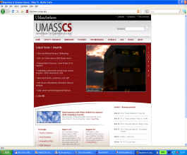


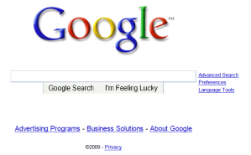
A day in the life: scenario
browser
DNS server
Comcast network
68.80.0.0/13
school network
68.80.2.0/24
web page
web server
Google’s network
64.233.160.0/19
64.233.169.105
Link Layer
5-<number>

Slide 35
A day in the life… connecting to the Internet
DHCP
DHCP
UDP
IP
Eth
Phy
connecting laptop needs to get its own IP address, addr of first-hop router, addr of DNS server: use DHCP
DHCP
DHCP
DHCP
DHCP
DHCP request encapsulated in UDP, encapsulated in IP, encapsulated in Ethernet
DHCP
DHCP
UDP
IP
Eth
Phy
DHCP
DHCP
DHCP
DHCP
router
(runs DHCP)
Ethernet frame broadcast (dest: FFFFFFFFFFFF) on LAN, received at router running DHCP server
Ethernet demuxed to IP demuxed, UDP demuxed to DHCP
Link Layer
5-<number>

Slide 36
A day in the life… connecting to the Internet
DHCP
DHCP
UDP
IP
Eth
Phy
DHCP server formulates DHCP ACK containing client’s IP address, IP address of first-hop router for client, name & IP address of DNS server
DHCP
DHCP
DHCP
encapsulation at DHCP server, frame forwarded (switch learning) through LAN, demultiplexing at client
DHCP
DHCP
UDP
IP
Eth
Phy
DHCP
DHCP
DHCP
router
(runs DHCP)
DHCP
DHCP client receives DHCP ACK reply
Client now has IP address, knows name & addr of DNS
server, IP address of its first-hop router
Link Layer
5-<number>

Slide 37
A day in the life… ARP (before DNS, before HTTP)
DNS
UDP
IP
Eth
Phy
before sending HTTP request, need IP address of www.google.com: DNS
DNS
DNS
DNS
ARP
ARP query
DNS query created, encapsulated in UDP, encapsulated in IP, encapsulated in Eth. To send frame to router, need MAC address of router interface: ARP
ARP
ARP reply
Eth
Phy
router
(runs DHCP)
ARP query broadcast, received by router, which replies with ARP reply giving MAC address of router interface
client now knows MAC address of first hop router, so can now send frame containing DNS query
Link Layer
5-<number>

Slide 38
A day in the life… using DNS
DNS
UDP
IP
Eth
Phy
DNS
DNS server
DNS
UDP
IP
Eth
Phy
DNS
DNS
DNS
DNS
DNS
DNS
DNS
DNS
Comcast network
68.80.0.0/13
IP datagram forwarded from campus network into comcast network, routed (tables created by RIP, OSPF, IS-IS and/or BGP routing protocols) to DNS server
router
(runs DHCP)
IP datagram containing DNS query forwarded via LAN switch from client to 1st hop router
demux’ed to DNS server
DNS server replies to client with IP address of www.google.com
Link Layer
5-<number>

Slide 39
A day in the life…TCP connection carrying HTTP
HTTP
HTTP
TCP
IP
Eth
Phy
SYNACK
SYN
SYNACK
SYN
SYNACK
SYN
SYN
to send HTTP request, client first opens TCP socket to web server
router
(runs DHCP)
TCP SYN segment (step 1 in 3-way handshake) inter-domain routed to web server
TCP
IP
Eth
Phy
SYNACK
SYN
SYNACK
SYN
SYNACK
SYN
SYNACK
web server responds with TCP SYNACK (step 2 in 3-way handshake)
web server
64.233.169.105
TCP connection established!
Link Layer
5-<number>

Slide 40
A day in the life… HTTP request/reply
HTTP
HTTP
TCP
IP
Eth
Phy
web page finally (!!!) displayed
HTTP
HTTP
HTTP
HTTP
HTTP
HTTP
HTTP
HTTP
HTTP request sent into TCP socket
router
(runs DHCP)
IP datagram containing HTTP request routed to www.google.com
HTTP
HTTP
TCP
IP
Eth
Phy
HTTP
HTTP
HTTP
web server responds with HTTP reply (containing web page)
HTTP
web server
64.233.169.105
IP datagram containing HTTP reply routed back to client
Link Layer
5-<number>

